Slide 1
Introduction to Python

Slide 2
Table of contents
Introduction
Tools
Conda
Jupyter Notebook
Google Colaboratory
Main concepts
Hands-on (notebook)
Standard Python
numpy
matplotlib

Slide 3
Introduction

Slide 4
Why Python?
Easy to learn!
Easy to read
Almost like writing a series of instructions
High-level language
Object oriented
Interpreted language
No need to compile
Multi-platform
Linux, Windows, OSX

Slide 5
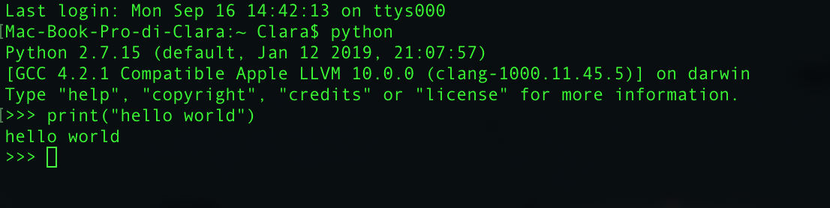
Python Execution
Interactive Mode
Run “python” in terminal
Start writing code
Non-interactive Mode
Create a text file containing your code, e.g., “code.py”
Run the code directly from file using the interpreter, i.e., “python code.py”

Slide 6
Tools

Slide 7
Package Manager
Packages and Modules
Python can be easily expanded through packages and modules
numpy, scikit-learn, etc.
PIP
pip install numpy
Conda
conda install numpy
Others…

Slide 8
Python Tools
For the next labs you can:
choose to install Python and its tools locally on your computer (suggested)
use Google Colaboratory

Slide 9
Install Python locally: Conda
Conda is an open source package management system and environment management system.
compatible with Windows, MacOS, Linux
install, run and updates packages and their dependencies
creates, saves, loads and switches between environments
created for Python but it can package and distribute software for any language (in theory…)

Slide 10
Install Python locally: Miniconda
Miniconda is a small installer for conda: it includes conda, Python, the packages they depend on and some packages.
https://docs.conda.io/en/latest/miniconda.html
Note: we will use Conda to install Python too (it is included!). If you have previous versions of Python they will not be affected by the Conda installation.

Slide 11
Install Python locally: Miniconda Mac OS
Download Miniconda3 Python 3.8 pkg version (not bash) for MacOS
Run the installer
Open Terminal (or similar)
Write and run conda update conda
if you see something like (base) at the start of the line in your Terminal, then it means that the base environment of Conda is activated by default on startup. If you want to disable this, run:
conda config --set auto_activate_base false
Note: the installation path will be something like /Users/name/opt/miniconda3
Every time you will need to use Conda, you will need to open the Terminal application

Slide 12
Install Python locally: Miniconda Windows
Download Miniconda3 Python 3.8 for Windows
Run the installer leaving default options
When it is finished, you will have a new application called Anaconda Powershell Prompt
Open Anaconda Powershell Prompt and run conda update conda
Note: everytime we will use Python and Conda you will need to use this prompt

Slide 13
Install Python locally: Create an environment
What is a conda environment and why is it so useful?
Using conda, you can create an isolated python environment for your project. An environment is a set of packages that can be used in one or multiple projects
There are two ways of creating a conda environment.
manual specifications of packages
specify environment file in YAML format (environment.yml)

Slide 14
Install Python locally: Environment manual creation
conda create -n name_of_the_environment python=3.8
you can specify a version of Python, install at creation time some specific packages with specific versions of the package

Slide 15
Install Python locally: Creation from an yml file
define an yml file (we are not going to do this today) https://docs.conda.io/projects/conda/en/latest/user-guide/tasks/manage-environments.html#create-env-file-manually
for creating the environment from an yml file conda env create -f environment.yml

Slide 16
Install Python locally: Activation of the environment
For using the environment you will first need to activate it
conda activate name_of_the_environment
To de-activate the environment and return to your basic shell
conda deactivate

Slide 17
Install Python locally: Install packages with conda
When you are inside an environment you can install packages using
conda install name_of_the_package
These packages are valid and will be accessible only from this environment.
Try to install some packages in the new created environment. First activate the environment and then install:
numpy
scipy
jupyter notebook

Slide 18
Install Python locally: IDE and Editors
Jupiter Notebook
is an open-source web application that allows you to create and share documents that contain live code, equations, visualizations and narrative text.

Slide 19
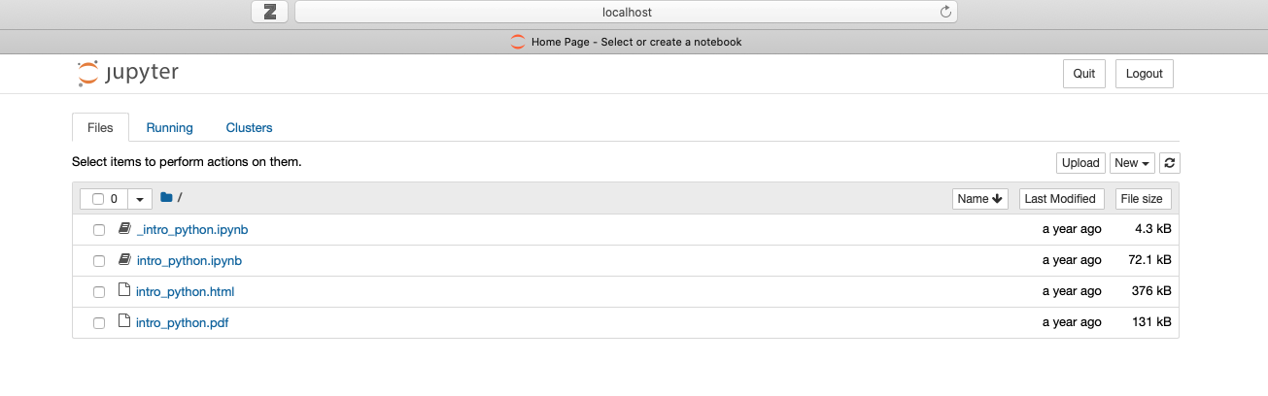
Install Python locally: Jupyter Notebook
When you type jupyter notebook in your conda env →
A new window in a browser should be opened automatically.
The windows is the user interface that access to Jupyter Notebook server on the address localhost:8888 (usually, you can check it on the output in the terminal).
All the notebooks present in the folder from which you launched the command are visible and executable.

Slide 20
Install Python locally : Instructions for the LABS
During these labs:
I will upload the needed notebooks and files on BeeP portal as a ZIP file. Usually it will be something like:
.
|--notebook1.ipynb
|--notebook2.ipynb
|--audio
| |--audio1.wav
| |--audio2.wav
|--img
| |--img1.png
| |--img2.png
Do not change this hierarchy! We will need it for loading audio files and images in our notebooks!

Slide 21
Install Python locally : Instructions for the LABS
Download and unzip the ZIP file
Navigate with the Terminal/Anaconda Powershell Prompt in the folder in which you have the lab folder
Run conda activate name-of-the-environment
Run jupyter notebook
The notebooks I will provide you are partially empty: together, during the labs, we will write and run the code for completing them
If you need a package in your code, you can always install it by calling conda install name_of_the_package inside your environment

Slide 22
Use Python on the web: Google Colab
Google Colaboratory
allows you to write code and test it directly on the browser. It is, in practice, a Jupyter Notebook which runs on remote servers of Google.
The notebook are automatically saved on your Google Drive.
Drawbacks:
the service is not always guaranteed and the session expires after some time
loading external files can be complex

Slide 23
Use Python on the web: Google Colab
open the link https://colab.research.google.com/notebooks/intro.ipynb
to create an empty notebook click on File / Create New Notebook (Note: you have to be logged in Google)
to load a notebook (like the one I will provide you for the labs) use File / Load New Notebook
write and execute you code
if you need an external package not already included use !pip install name_of_the_package https://colab.research.google.com/notebooks/snippets/importing_libraries.ipynb
if you need external file use the left side panel and load them directly; in alternative check this https://colab.research.google.com/notebooks/io.ipynb

Slide 24
Use Python on the web: Instructions for the LABS
Download and unzip the ZIP file
Load the notebooks on Google Colab
Install necessary packages not included
Load the audio and images files in the Google Colab session, keeping the hierarchy

Slide 25
Main Concepts

Slide 26
Comments
Text ignored during execution
Useful to describe what is happening in the code to the reader
Comments start with character #
… till the end of the line
Character # can still be used in strings
# this is the first comment
SPAM = 1 # and this is the second comment
# ... and now a third!
STRING = “# This is not a comment”.

Slide 27
Numbers
In interactive mode, Python prints operation outputs
Common operators are *, +, -, /
Characters ( and ) can be used to group operations
Warning: Python2 vs. Python3 integer division!!
>>> 2*2
4
>>> (50-5*6)/4
5
>>> 7/3 #integer division returns the floor
2
>>> 2**3 #exponentiation
8
Notes:
In Python2 / corresponds to classic division that, when presented with integer operands, truncates the decimal place returning an integer ( floor division)
In Python3 it corresponds to real division and it returns the real floating point quotient, regardless the operand type

Slide 28
Variables
It is possible to associate values to variables
Python exploits dynamic typing
No need to declare variable type (e.g., int, float, char, etc.)
Warning: do not confuse = (i.e., assignment) and == (i.e., comparison)
>>> a = 20
>>> b = 5*9
>>> a * b
900

Slide 29
Strings
String is a structure containing text data
Declared using ‘ or “
Escape character \ is used to include ‘ or “ within strings
print can be used to show string content
Warning: Python2 vs. Python3 print syntax
>>> print(‘spam eggs’)
spam eggs
>>> print(‘doesn\’t’)
doesn’t
>>> print(“doesn’t”)
doesn’t
>>> print(‘”Yes,” he said.’)
”Yes,” he said.
>>> print(“\”Yes,\” he said.”)
“Yes,” he said.
>>> print(‘”Isn\’t,” she said.’)
“Isn’t,” she said.
Notes:
Depending on the character you are using for declaring, you need to use escape character or not.
With Python3 you need to use print as a function

Slide 30
List and tuples
Lists are sequences of editable variables
Lists can be concatenate, sorted, re-ordered, etc.
Declared using [ and ]
Tuples are non-editable
Declared using ( and )
>>> a = [‘spam’, ‘eggs’, 100, 1234]
>>> a
[‘spam’, ‘eggs’, 100, 1234]
>>> a[0]
‘spam’
>>> a[1:3]
[‘eggs’, 100]
>>> a[:2] + [‘bacon’, 2*2]
[’spam’, ’eggs’, ‘bacon’, 4]
>>> a.append(9.87)
>>> a
[’spam’, ‘eggs’, 100, 1234, 9.87]

Slide 31
Control Structures
If / Else
use operators <, >, ==, !=
For
hints: ‘zip’, ’enumerate’, ‘tqdm’
>>> x = 5
>>> if x < 0:
... print(’negative’)
... elif x == 0:
... print(‘zero’)
... else:
... print(‘positive’)
...
positive
>>> # Measure some strings
... a = [‘cat’, ‘window’, ‘defenestrate’]
>>> for x in a:
... print(x, len(x))
...
cat 3
window 6
defenestrate 12
Notes:
zip joins two tuple together: in particular, having N iterators (tuples) as input, it returns an iterator where the first item of each passed iterator is paired together, the second item of each passed iterator is paired together, ecc
enumerate allows to loop over something and have, at the same time, a counter; you can eventually specify from where to start the counter/index (default is 0)
tqdm is a library that allows to instantly make your loops show a progress meter

Slide 32
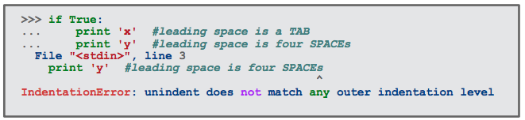
Indentation
Python uses indentation to group code portions
Hard constraint!
Indentation must be uniform
Use the same amount of tabs or spaces for each group of codes

Slide 33
Functions
Defined using constructor ‘def’
Can return multiple variables as well as lists
Warning: risk of changing variable values outside functions
>>> def power (base, exponent):
... return base**exponent
...
>>> power(2,3)
8
>>> power(2,4)
16
>>> range(4) #Standard Python function
[0, 1, 2, 3]
Notes:
in case of lists and other mutable variables (like numpy array), if they are argument of a function they will be passed by reference

Slide 34
Modules
Files containing multiple functions and instructions
also known as libraries
Python contains some standard modules (e.g., os, math, sys, etc.)
Modules must be imported before use (i.e., import …)
It is possible to import submodules (i.e., from … import …)
>>> import os
>>> os.getcwd()
‘/Users/Clara/’
>>> from math import factorial
>>> factorial(5)
120

Slide 35
Object-oriented Programming
It is possible to use “special” variables that contains functions and other variables
These are generated starting from “classes”
class rettangolo:
def __init__(self, l1, l2):
self.l1 = l1
self.l2 = l2
def area(self)
return self.l1*self.l2
>>> rett1 = rettangolo(2,5)
>>> rett1.area()
10
>>> rett1 = rettangolo(4,4)
>>> rett1.area()
16

Slide 36
Hands on

